Slide 1

Database Encryption and SQL Injection
Information Security Presentation(Sem 2)
Presented by – Shubham Ambrale(04), Shravan Mudaliar(43),Nayan Patil(53), Pravin nair(50), Sahil More(42).

Slide 2
Introduction
With the rise of cyberattacks, data breaches, and online threats, securing sensitive information is a top priority. Protecting personal, financial, and organizational data ensures trust, legal compliance, and operational continuity.
This presentation highlights SQL Injection, a code injection technique used to access or alter database data, and Database Encryption, which protects data at rest by converting it into unreadable ciphertext without the right keys.

Slide 3
Database Encryption
The database is typically the most valuable information resource for any organization
and is therefore protected by multiple layers of security, including firewalls,
authentication mechanisms, general access control systems, and database
access control systems.
For particularly sensitive data, database encryption is warranted and often implemented.
Encryption becomes the last line of defence in database security.

Slide 4
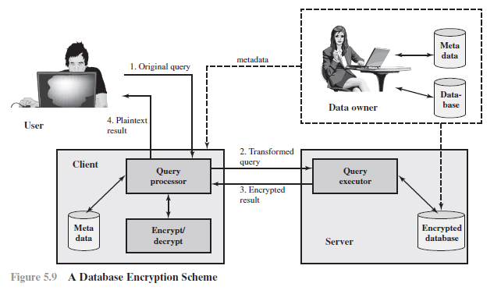

Slide 5
Entities involved in Database Encryption
Data owner: An organization that produces data to be made available for controlled release, either within the organization or to external users.
User: Human entity that presents requests (queries) to the system.
The user could be an employee of the organization who is granted access to the
database via the server, or a user external to the organization who, after authentication, is granted access.
Client: Front end that transforms user queries into queries on the encrypted data stored on the server.
Server: An organization that receives the encrypted data from a data owner and makes them available for distribution to clients.
The server could in fact be owned by the data owner but, more typically, is a facility owned and maintained by an external provider.

Slide 6
Entities involved in Database Encryption
A user at the client can retrieve a record from the database with the following sequence:
The user issues an SQL query for fields from one or more records with a specific value of the
primary key.
The query processor at the client encrypts the primary key, modifies the SQL query and
transmits the query to the server.
The server processes the query using the encrypted value of the primary key and returns the
appropriate record or records.
The query processor decrypts the data and returns the results.

Slide 7
SQL Injection (SQLI)
SQLi is a code injection attack targeting a database via vulnerable input fields. It allows attackers to read, alter, or delete backend data.
How SQLi Works : - Attacker sends malicious SQL through web input → server executes it. This can bypass login, retrieve data, or even destroy tables.
SQLi is an attack that exploits a security vulnerability occurring in the database layer of an application (such as queries).
Using SQL injection, the attacker can extract or manipulate the web application’s data.
The attack is viable when user input is either incorrectly filtered for string literal escape characters embedded in SQL statements or user input is not strongly typed, and thereby unexpectedly executed.

Slide 8
Steps involved in SQLI
Hacker finds a vulnerability in a custom Web application and injects an SQL command to a database by sending the command to the Web server. The command is injected into traffic that will be accepted by the firewall.
The Web server receives the malicious code and sends it to the Web application server.
The Web application server receives the malicious code from the Web server and sends it to the database server.
The database server executes the malicious code on the database. The database returns data from credit cards table.
The Web application server dynamically generates a page with data including credit card details from the database.
The Web server sends the credit card details to the hacker.

Slide 9
Examples of SQLI Attacks:
Bypassing Authentication using 1=1 :
Attackers inject code like ' OR 1=1 -- into login forms to manipulate the SQL query.
This makes the condition always true (since 1=1 is always true), allowing unauthorized access
without valid credentials.
SELECT * FROM users WHERE username='' OR 1=1 --

Slide 10
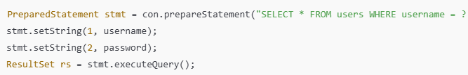
Preventing SQL Injection
Use Prepared Statements (Parameterized Queries) –
Prepared statements ensure that user input is treated as data, not code. Instead of concatenating SQL queries with raw input, placeholders (‘ ? ’) are used, and the database safely binds user values.

Slide 11
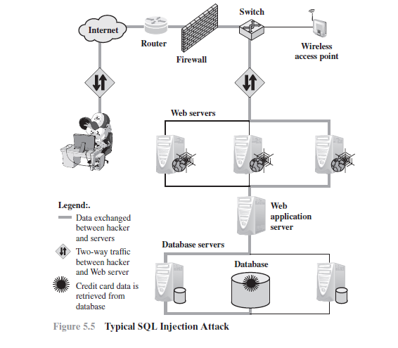

Slide 12
Real-World SQLi Incidents
Sony (2011): Exposed Millions of Records
Hackers exploited a SQL injection flaw in Sony's PlayStation Network, gaining access to over 77 million user accounts, including emails and passwords. The breach caused massive reputation damage and forced Sony to shut down its network for 23 days.
TalkTalk Telecom (2015): Teen Hacked via SQLi
A 17-year-old exploited a SQL injection flaw in TalkTalk’s website to access sensitive customer data including names, emails, and financial info.
The breach affected over 150,000 customers and highlighted serious lapses in basic cybersecurity.

Slide 13
Conclusion
SQL Injection is a major web security vulnerability that allows attackers to manipulate backend databases.
Common SQLi techniques like ‘1=1 and DROP TABLE can lead to unauthorized access or total data loss.
Using parameterized queries and prepared statements is the most effective way to prevent SQLi.
Database encryption acts as a last line of defense, protecting sensitive data even if a breach occurs.
Encryption ensures confidentiality and integrity, especially for credit card details, passwords, and personal records.
Secure coding practices and strong encryption policies form a robust defense against modern threats.

Slide 14
Thankyou

